Slide 1
ASTA Issues Update
Andy LaVigne
ASTA President & CEO
California Seed Association – Mid Year Meeting
Monterey, CA
Sept. 21, 2016

Slide 2
2015-16 Officers
Chairman Mark Herrmann, AgReliant Genetics, Westfield IN
1st Vice Chair Tracy Tally, Justin Seed Co., Justin TX
2nd Vice Chair Jerry Flint, DuPont Pioneer, Johnston IA
President & CEO Andy LaVigne, ASTA, Alexandria VA

Slide 3
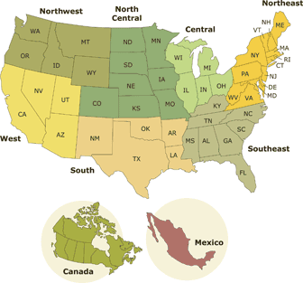
Regional Vice Presidents
Dave Pearl, Western Region RVP
Cisco Co., Indianapolis, IN

Slide 4
Mission
“ASTA promotes the development of better seed to produce better crops for a better quality of life.”
Notes:
The American Seed Trade Association, directed by its members, is involved in nearly all issues relating to plant germplasm, focusing on three areas of industry importance:
Regulatory and legislative matters at international, national and state levels;
New technologies impacting all crop species; and
Communication and education of members and appropriate public audiences regarding science and policy issues affecting the seed industry.
Activities include enhancing the visibility of seed issues in the public arena; advocating industry-wide positions on policy issues; informing members about environmental and conservation issues and new developments in plant breeding, such as the use of modern biotechnology; conducting meetings to inform members about seed issues and to encourage fellowship among seed professionals; promoting global sales of US seeds; funding select seed research programs; and maintaining positive working relationships with related professional organizations.

Slide 5
Federal Affairs Update
Labeling of Food containing GMO Products
Passed the Senate July 6 – 63 – 30
Passed the House July 14 – 306 - 117
Signed by President Obama July 29
Implementation – up to 2 yrs.
Food Safety Modernization Act
Seed out unless used for feed
Seed Treatment Lawsuit

Slide 6
Federal Affairs Update
Organic Seed
Field crops – corn issue
Vegetable crops
Plant Breeding Innovations
Domestic policy options/implications
International implications, ASTA very involved
Communications Effort
Plant breeding in general
Gene editing techniques

Slide 7
Federal Affairs Update
Anderson vs. EPA: Seed Treatment Lawsuit - Overview
Seeds treated with systemic pesticides must be regulated as pesticides under the Federal Insecticide, Fungicide and Rodenticide Act (FIFRA)
EPA Policy - The “treated article exemption”
Notes:
Examples – wood pallets, boat anti-fowling paint,

Slide 8
Federal Affairs Update
Anderson vs. EPA: Seed Treatment Lawsuit- Timeline
EPA responded to the Complaint March 9, 2016
ASTA, CLA, grower orgs are intervenors
Grounds for dismissal - the plaintiffs aren’t challenging a final agency action (a requirement) - challenging policy.
If plaintiffs are not successful they could petition EPA to challenge policy.

Slide 9
Federal Affairs Update
Contact:
Jane DeMarchi or Virginia Houston at SeedFirstPAC@gmail.com
Notes:
Every day, issues that impact the seed industry are being discussed on Capitol Hill.
Actions taken by Congress can have a significant impact on the seed industry’s ability to make long-term investments in new tools and technologies to address the challenges we face as a global society. Your contributions to SeedFirstPAC will make a difference in Washington. These contributions will be used to help candidates who are supportive of key seed industry issues.
By contributing $500, $1,000, or $1,500 to SeedFirstPAC, you are ensuring your voice is heard on Capitol Hill. With your help, seed industry advocates will be there as issues move through Congress.
Your contributions ensure the seed industry has a strong and unified voice on Capitol Hill. Your donation will be amplified through coordination with member company PACs and like-minded associations to leverage donations for maximum impact.
By contributing to SeedFirstPAC, you are ensuring your voice is heard on all issues relating to the seed industry - from innovation in plant breeding and international trade, to labeling, environmental conservation, and more. With your help, seed industry advocates will be there as issues move through Congress.
How to Donate
Any amount will help! SeedFirstPAC currently accepts checks and credit cards. If you have questions about contributions or would like to donate, e-mail Jane DeMarchi or Virginia Houston at SeedFirstPAC@gmail.com.

Slide 10
State & Regional Update
Major Issues
GMO Labeling
Vermont law went into effect July 1 – now pre-empted!
State Seed Pre-emption
2016 legislation passed in four states
25 states with seed preemption
Seed Libraries
Law passed in Illinois
Law under consideration in California
Seed Lab Uniformity
Ongoing process
Arbitration
RUSSL amendment being considered to deny lawsuits until after arbitration is complete
Notes:
GMO Labeling
Vermont law goes into effect July 1st
Pre-emption
Statute that disallows local municipalities from enacting rules that are more stringent than state law within a specific subject.
Preemption language is included in the Recommended Uniform State Seed Law.
Partner initiative with BIO to expand adoption beyond the current 21 states
Libraries
ASTA working with AASCO to create a RUSSL amendment that establishes authorization (as opposed to an exemption).
Lab Uniformity
Coordinating efforts with the lab associations

Slide 13
Core Partners
Notes:
Brief description of each partner. Who else should be included here? NAPB? AMSAC? Others?

Slide 14
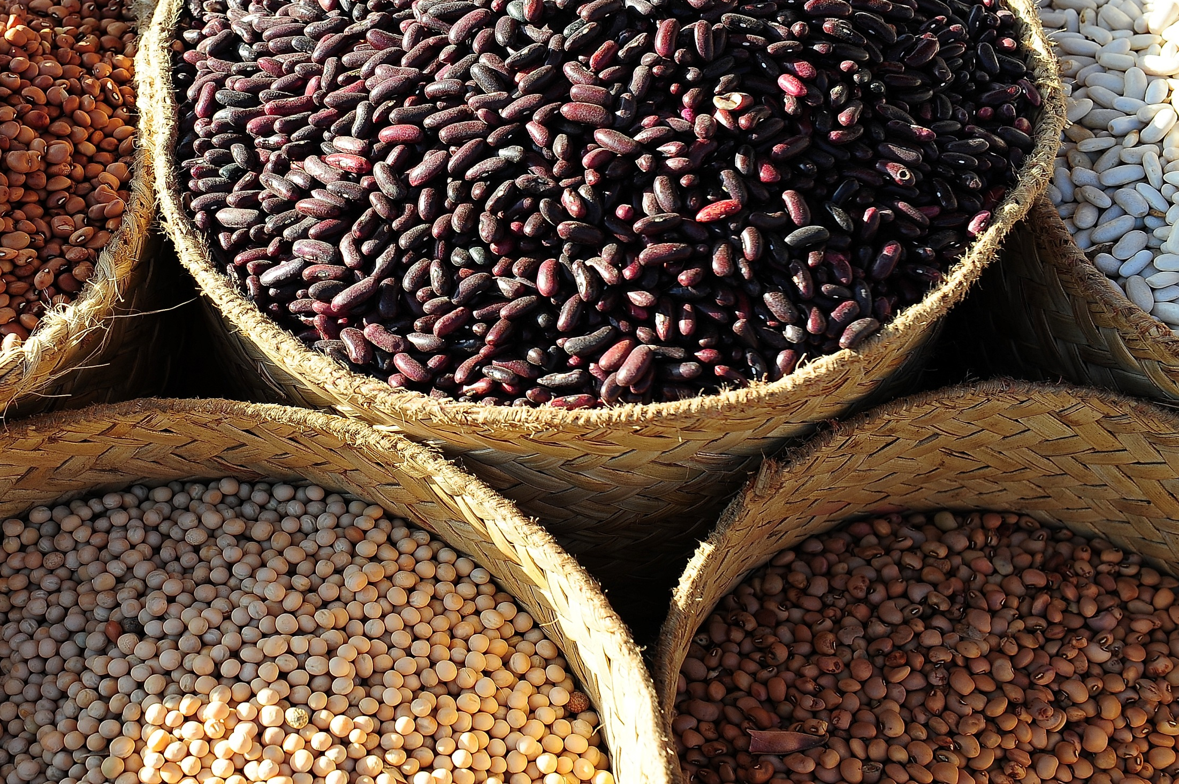
Communications & Advocacy
“Better Seed, Better Life”
Notes:
*Show BSBL video
BSBL Initiative -- Purpose: Increase consumer awareness about the value of seed and the importance of seed improvement

Slide 15
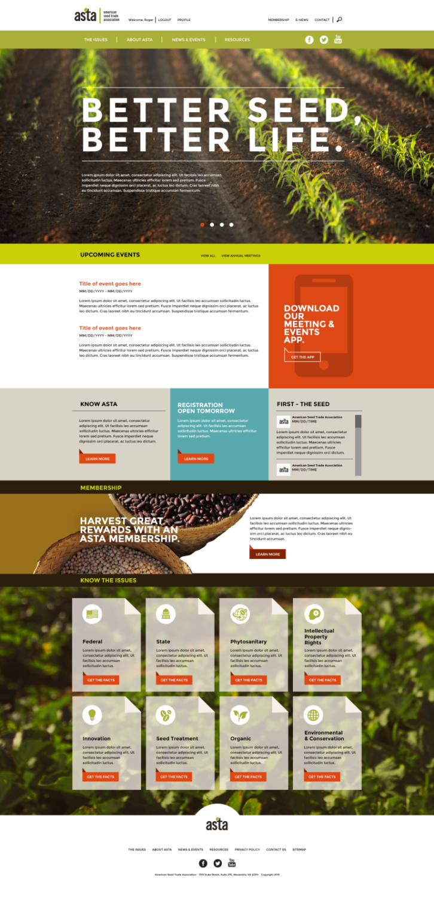
“Better Seed, Better Life” Communications Initiative
www.BetterSeed.org
The new “go to” source for value chain, industry allies & policymakers
Mobile-optimized, open-source CMS platform
Refreshed look and feel
ASTA Brand Refresh
Refreshed look & feel while honoring ASTA’s strong history
Updated logo variations to increase the utility of the brand and differentiate ASTA from other "A-S-T-A" organizations.
Core Messaging Deck & Modules
Customizable, turn-key resource
Notes:
Recent activities --
www.BetterSeed.org
The new “go to” source for value chain, industry allies & policymakers
Mobile-optimized, open-source CMS platform
Refreshed look and feel
ASTA Brand Refresh
Refreshed look & feel while honoring ASTA’s strong history
Updated logo variations to increase the utility of the brand and differentiate ASTA from other "A-S-T-A" organizations.
Core Messaging Deck & Modules -- Today, I’m going to walk through some of the slides to give you and idea of the looks & feel of our messaging
Deck is Customizable
Alternate photo options to appeal to your audience (ag production vs. home gardening)
Policy Modules (GMOs and Seed IP)
Can be given in10-25 minutes, depending on how long you have

Slide 16
FOOD
FEED
FUEL
FIBER
Many things that enhance our quality of life can be traced back to a seed someone planted.
Notes:
Core Deck Overview
As the cornerstone of our messaging, are bringing awareness to the idea that many of the things that enhance our quality of life can be traced back to a seed someone planted.
The food we eat, clothes we wear, the fuel that powers our cars—all these things and more start with a seed in the ground.
More importantly, some of the biggest challenges we face as a global society in the years ahead - from achieving food security to protecting our natural resources - can be addressed through the smallest of solutions: improved seed.

Slide 17
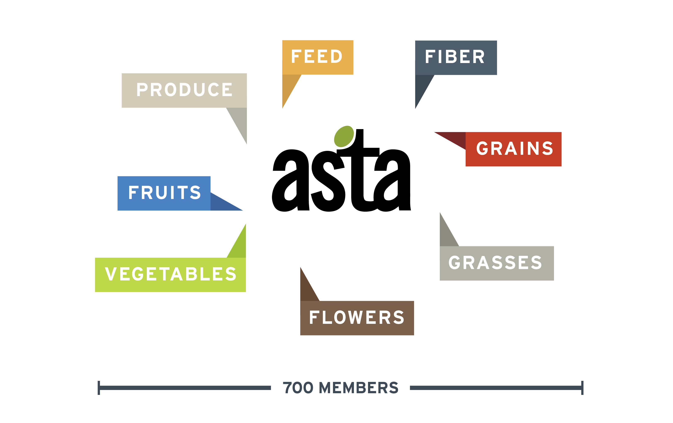
ASTA represents companies who breed, process and package seed of every type.
Notes:
Founded in 1883, the American Seed Trade Association (ASTA) represents over 700 companies involved in seed production, plant breeding and related industries in North America.
ASTA’s broad membership offers varieties from alfalfa to zucchini and all production types including conventional, organic and biotech.

Slide 18
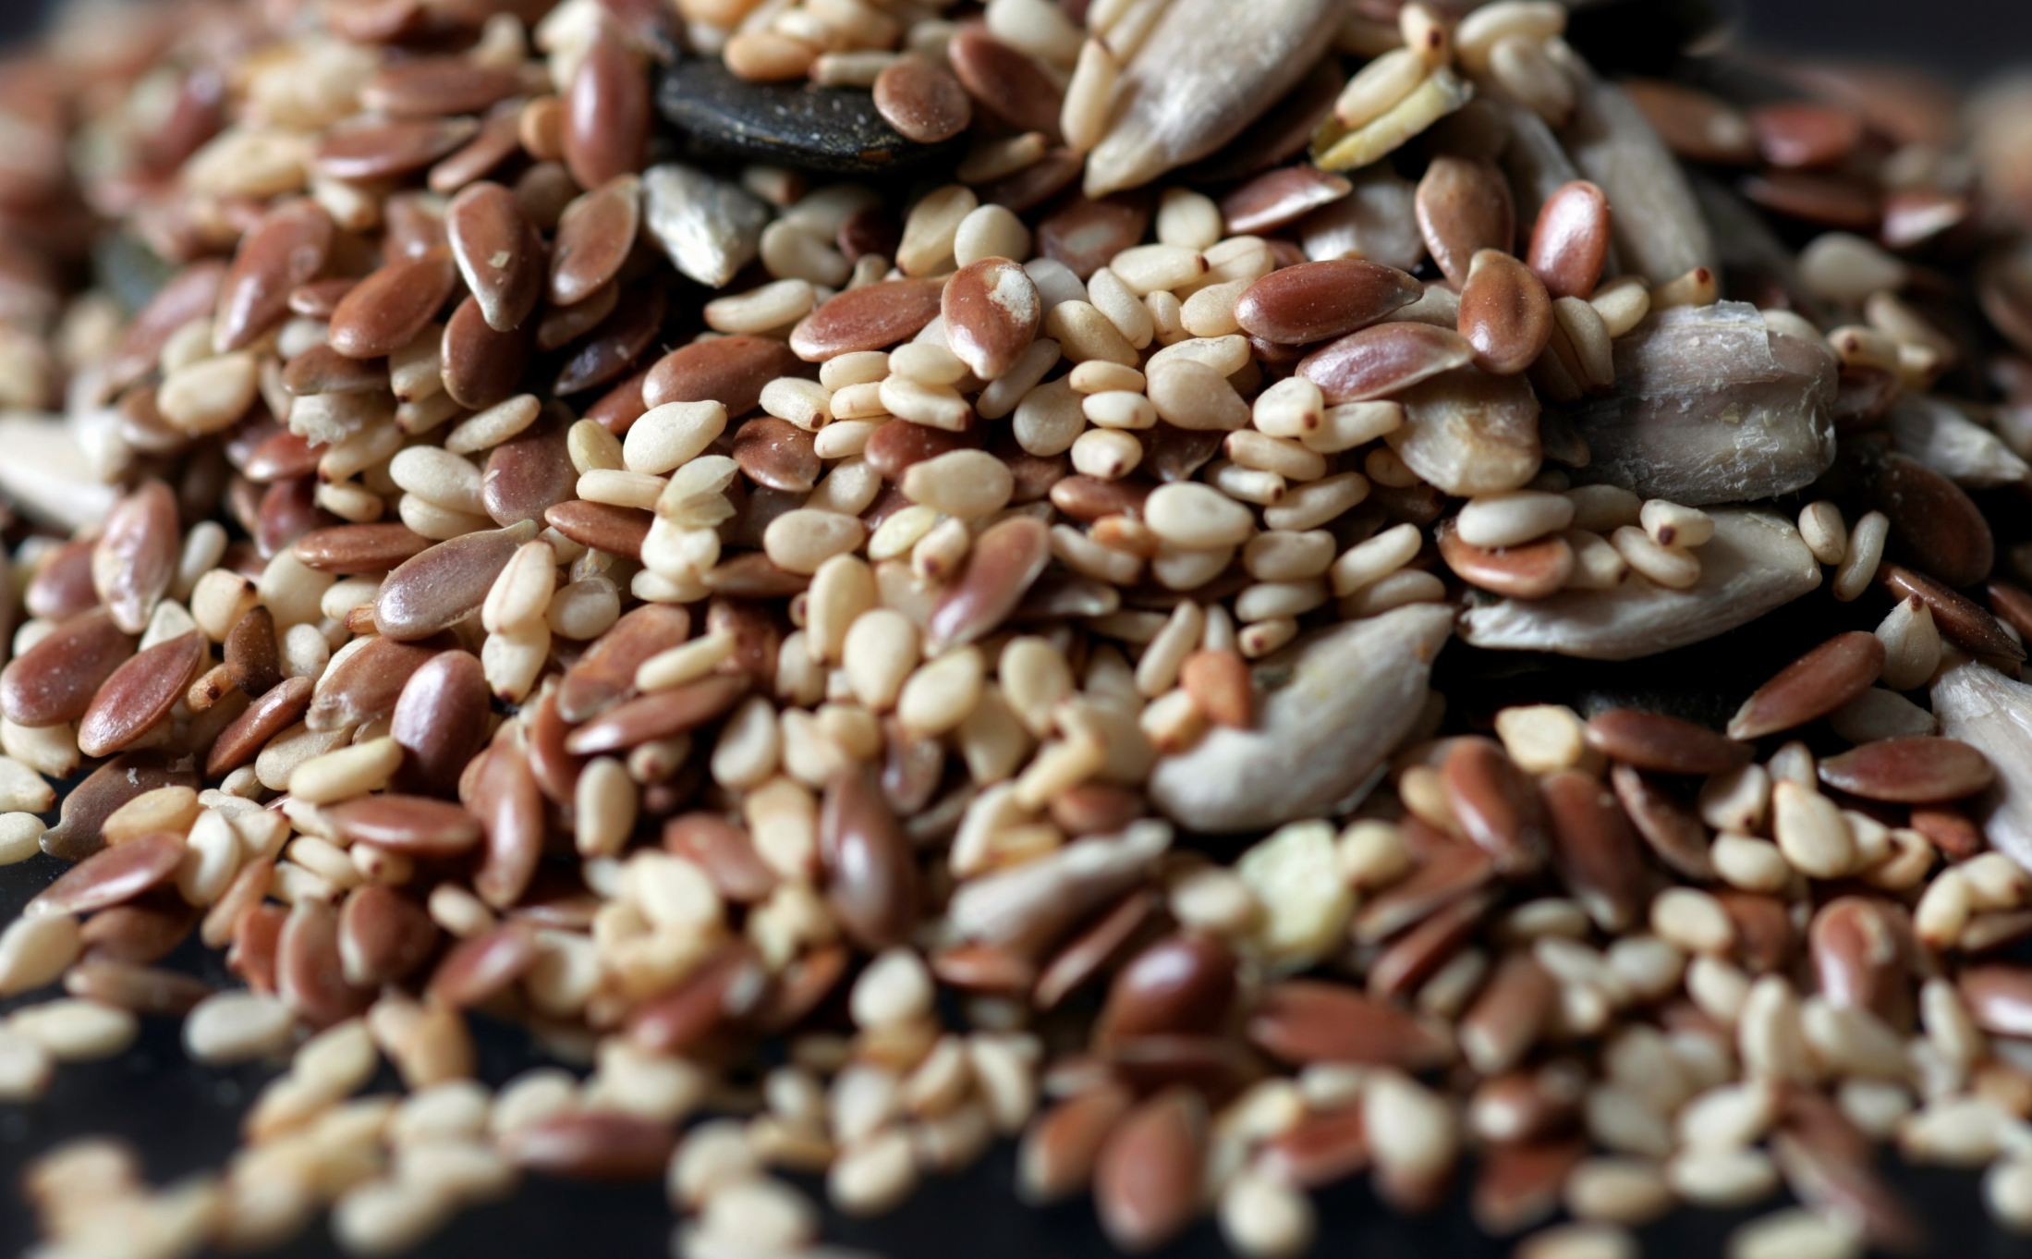
Seed improvement is about selecting new seed varieties through plant breeding tools and techniques.
Notes:
ASTA and our members are focused on seed improvement which refers to the many ways plant breeders create new seeds to address unmet needs of consumers, farmers and growers.
Plant breeding includes both new techniques and those that date back thousands of years.

Slide 19
Seed improvement delivers economic, environmental and health benefits.
ECONOMIC
ENVIRONMENTAL
HEALTH & WELLNESS
Notes:
Seed improvement is important because many factors that shape our quality life can be traced back to a seed planted in the ground.
The benefits of improved seed to our global society can be categorized into three macro categories:
economic viability,
protection and enhancement of our natural environment
and the health and well-being of people and animals.

Slide 20
ECONOMIC BENEFITS
Wide variety
Less waste
Consistent quality
Family farmers can sustain their way of life
Notes:
From an economic perspective, the seed industry is a powerful engine. According to The Context Network, it generates more than $15.5B annually in the United States across a diverse range of industry segments including agriculture, horticulture, home gardening and turf. It’s also responsible for providing seed annually for the more than 400 million acres of planted agriculture production in the US.
In addition to direct contributions to the economy, seed delivers many other types of economic benefits, like:
Less food waste because new varieties yield produce that stays fresh longer and has more consistent quality like more uniform peppers, and lettuce that has longer shelf life.
Larger varieties of food so families can make choices that are right for their needs and budget. For example there are more than 10,000 known varieties of tomato.
More efficient food production, enabling families in the U.S. to spend less money on food than families in other countries.
Improved fiber crops, resulting in fabrics that are stronger and softer.
And innovations like mildew-resistant spinach and drought-tolerant corn enable farmers to stay competitive in an ever-changing global marketplace.

Slide 21
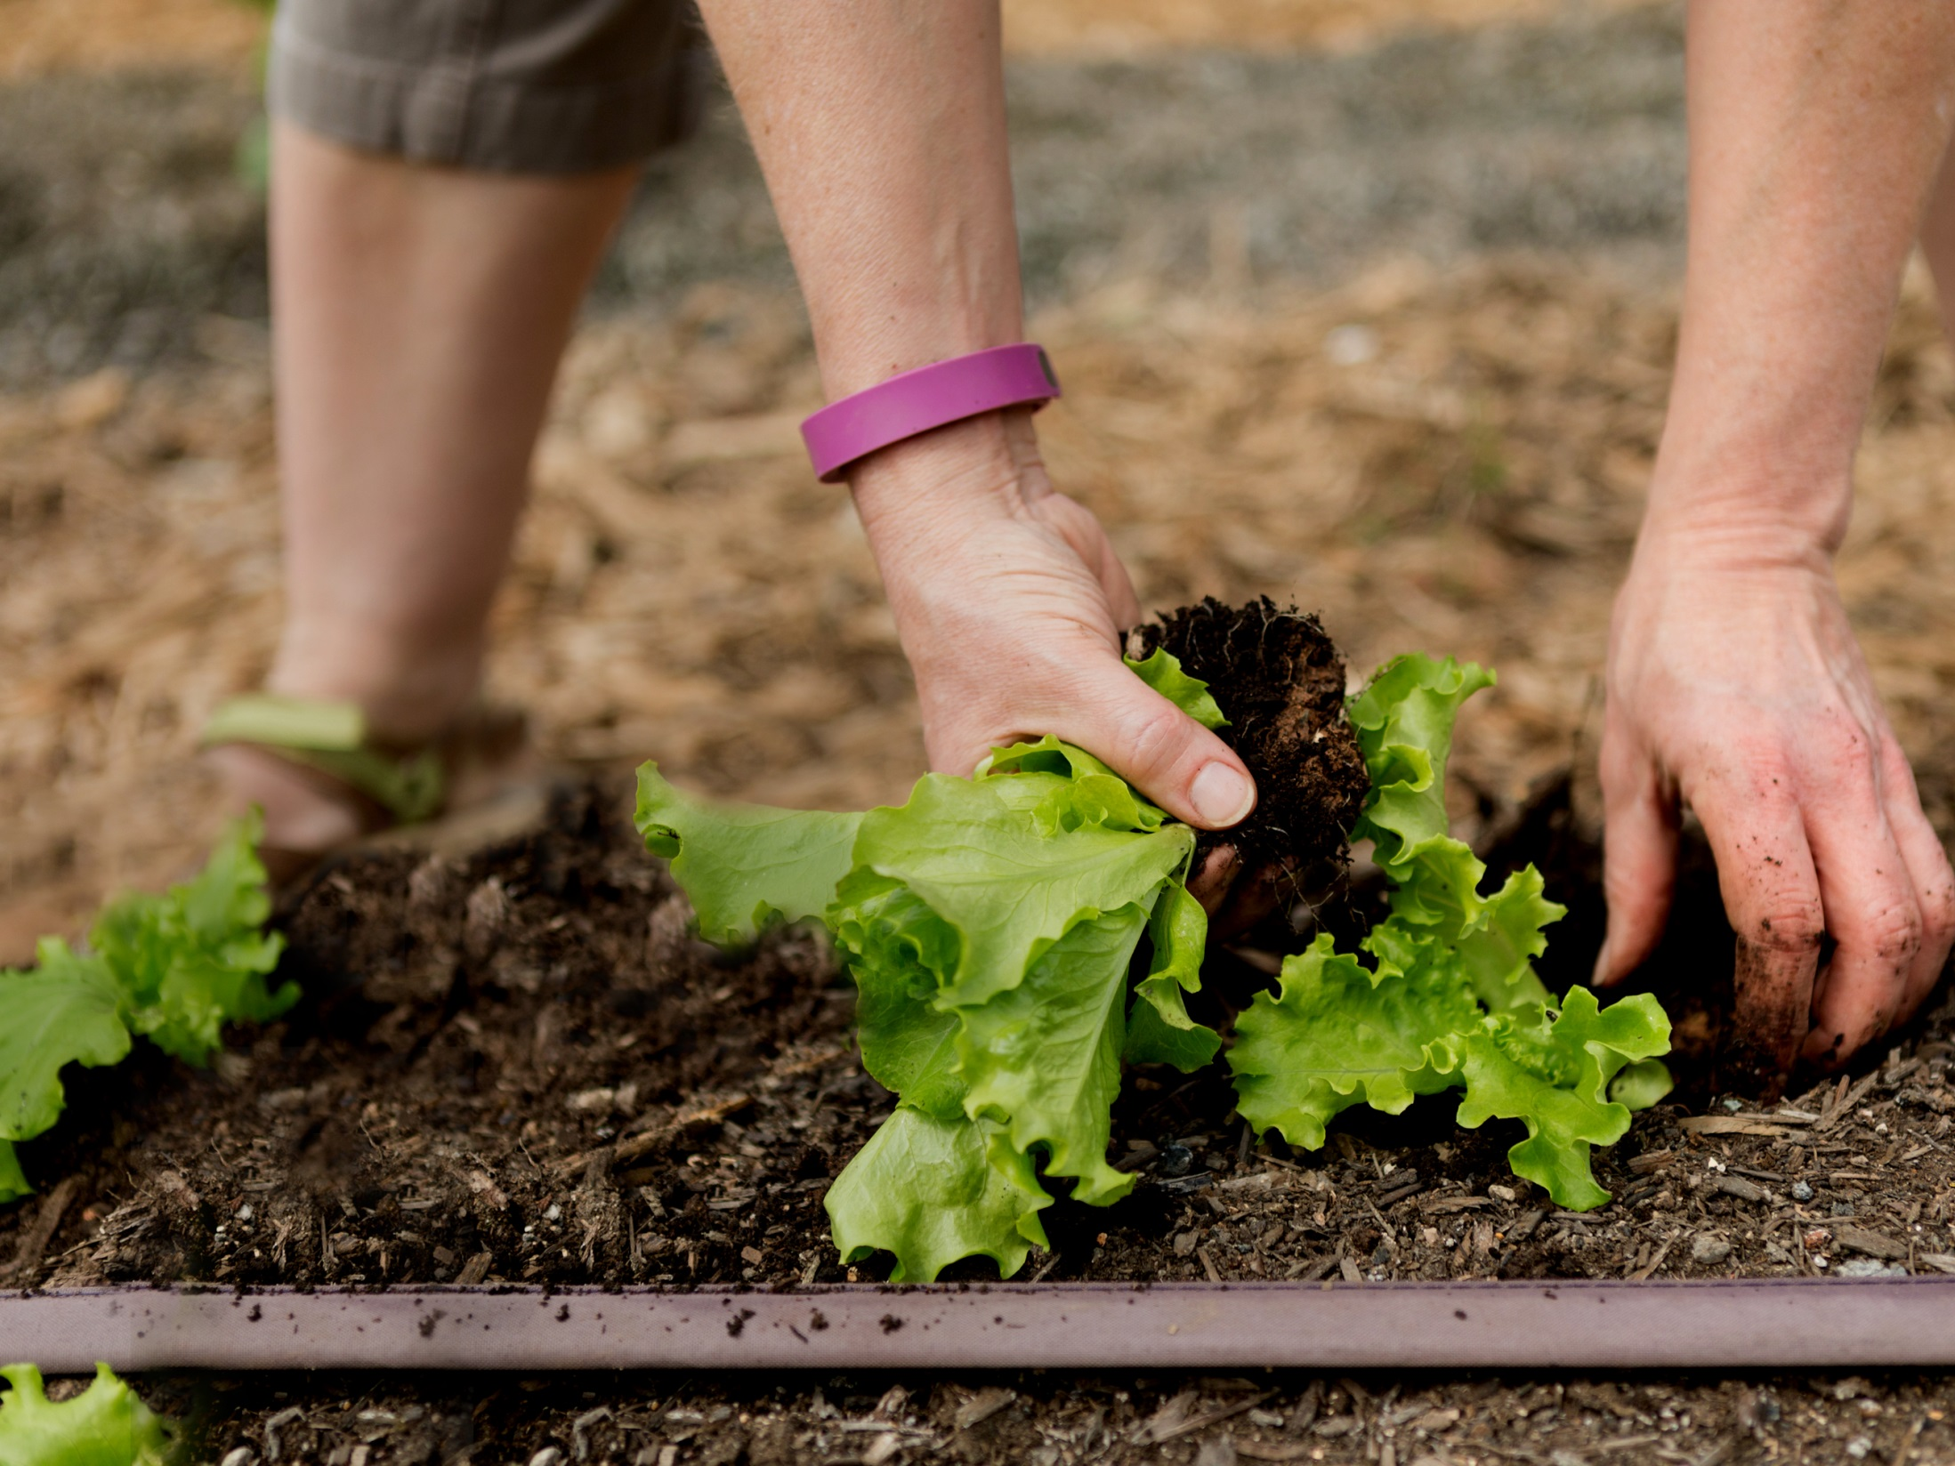
ENVIRONMENTAL BENEFITS
More food from the same land
Land restoration and reduced erosion
Reduced pesticide use
Efficient water use
Sustainable habitats
Notes:
Seed improvements also protects and enhance our natural environment. Thanks to seed improvement, we can --
Produce more food from the same land -- like grasses and grains used for feeding cattle. This will become increasingly important as the world’s population swells to an estimated 9 billion people by 2050.
Use less pesticides. Certain seed improvements have been estimated to allow farmers to reduce pesticide use by 19%
Produce plant that are ideal for restoring land damaged by mining, forest fires or other environmental disasters.
Improve the environment by producing plants that reduce soil erosion and use water more efficiently.
Establish more sustainable habitats for wildlife and pollinators and more nutritious and efficient feed for livestock.
And finally, improve our air quality

Slide 22
HEALTH & WELLNESS BENEFITS
More nutritious produce
Turf for sports/recreation
Wider variety of food
More successful home gardens
Notes:
Finally, seed improvements contribute to the health and well-being of people around the world. Some of these improvements include:
Produce that is healthier and more nutritious. For example, breeders have developed carrots with increased beta-carotene which improves both the appearance and nutrition profile.
Creating a wider variety of foods, including fruits and vegetables that are more convenient and appealing for consumers, such as personal sized watermelons and grape tomatoes.
Turf that is safer for sports or recreational use. For example, the NFL reports fewer injuries on natural grasses
Allowing home gardeners to have more successful backyard plots with heartier ornamental grasses and annuals.
Creating new, better tasting produce that is more likely to become part of a healthy diet. Like new butterscotch squash which is unusually rich, sweet, starchy flavor (ngb.org)
Cultivating flowers with more vibrant colors and more pleasing fragrances.

Slide 23
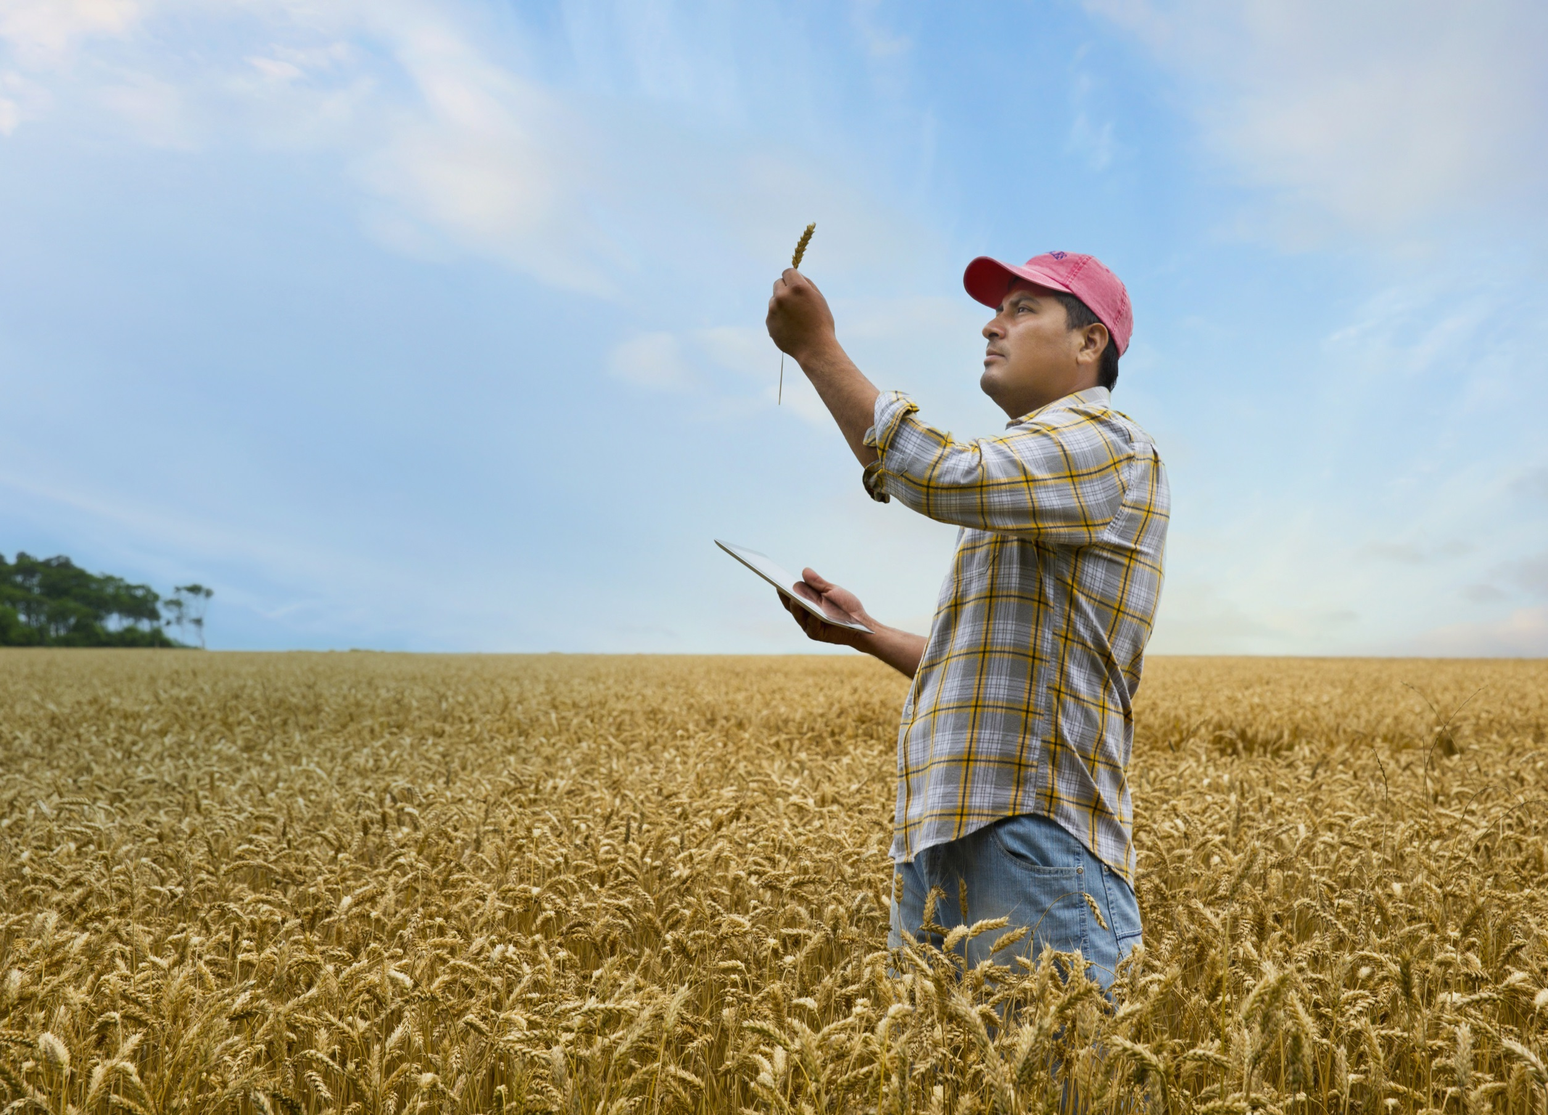
Seed improvements are driven by consumer demand, grower or gardener needs and evolving innovations.
Notes:
Plant breeding begins with a problem to be solved or an identified farmer/consumer need, such as better taste, smaller size or the ability to withstand drought, disease or insects.
What would your wish list include? Bite-size avocados? Snap peas without spines? Beets that don’t stain your hands? Extreme drought resistant maize?

Slide 24
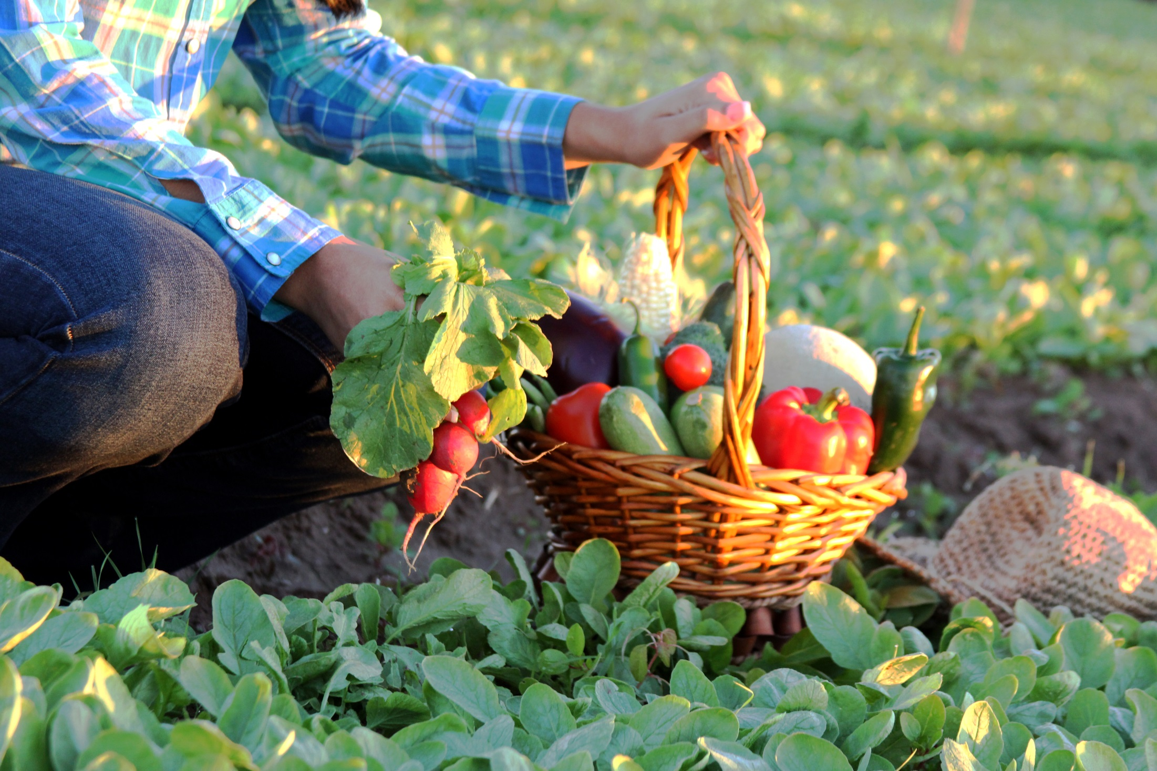
Breeders and researchers continue to improve plant breeding processes to create more desirable seed varieties.
Notes:
While plant breeding has evolved, it still involves the same three core tenets:
planting seeds
observing a characteristics of the resulting plants—like sight, touch, and taste
and selecting for the most desirable characteristics to breed the next generation of plants, drawing on the existing genetic variability within plants and related species.
Just as people begin a car trip by entering their destination into a GPS to avoid wrong turns that cost time and money, plant breeders today use advanced tools, information and improved methods with the goal to reach the same endpoint more accurately and efficiently.

Slide 25
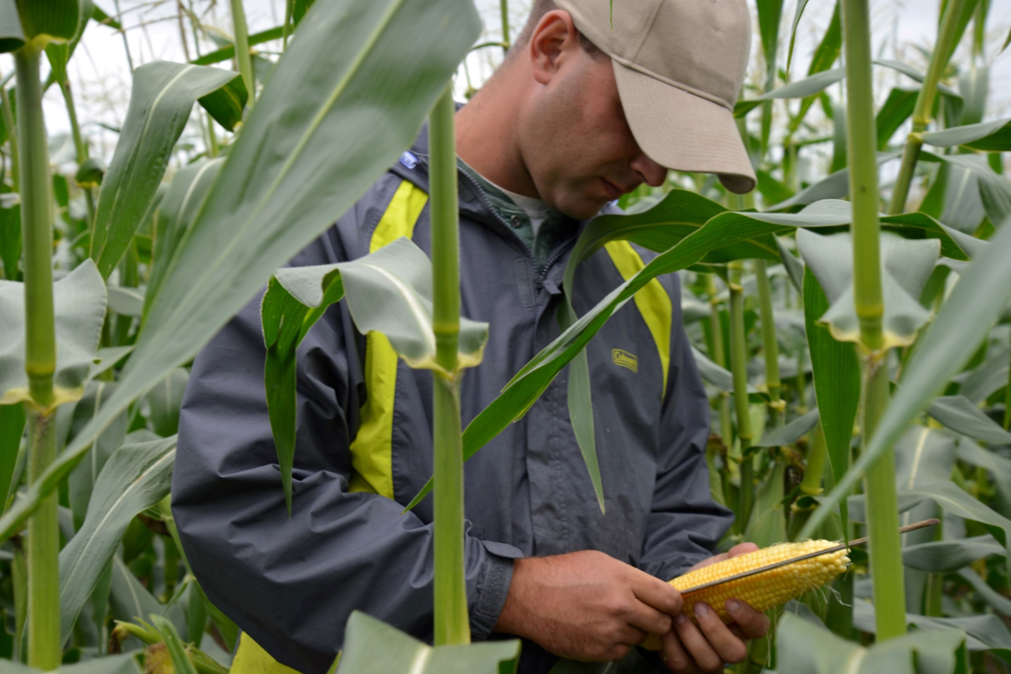
Plant breeders use precise methods to enhance or minimize specific plant qualities.
Notes:
With the new scientific knowledge and an increased understanding of plant biology and genetics, today’s breeding methods have become much more precise.
Based on knowledge of how plant genes function and sophisticated methods that harness natural plant characteristics, breeders can identify a variety combinations with desirable characteristics and then work with specific genes in the plant to enhance or minimize certain qualities.

Slide 26
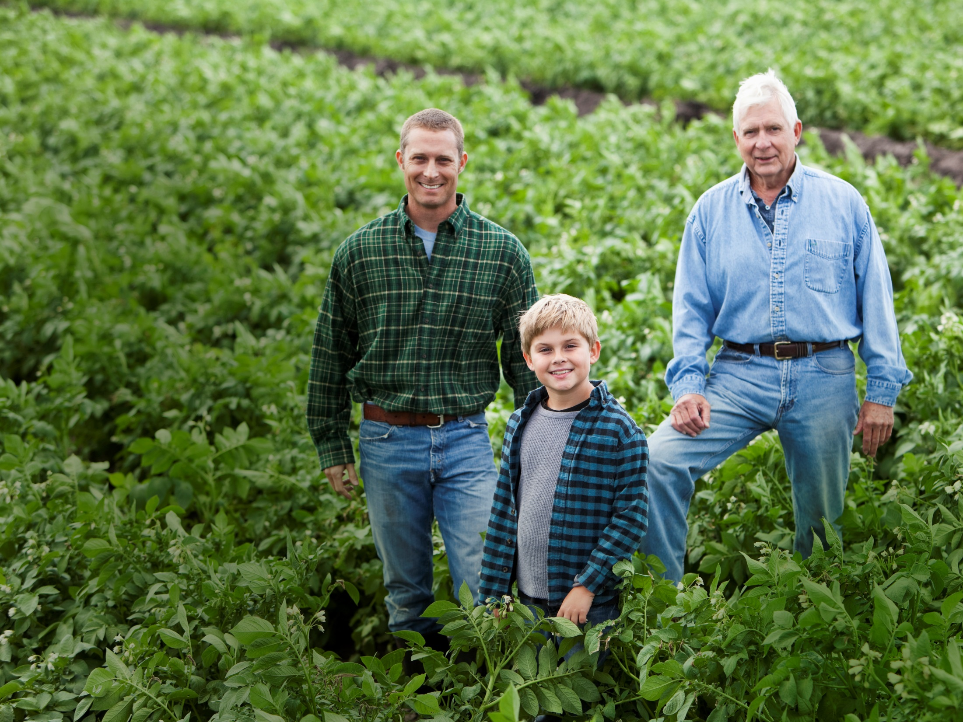
JOIN US
Champion the contributions of seed
Address misperceptions
Create a favorable environment for continued innovation around seed improvement
CONTACT
Bethany Shively
bshively@amseed.org
Notes:
Hopefully I’ve given you a sense for what ASTA wants to accomplish with this project.
We welcome the opportunity to collaborate. If you have seed-related stories you’d like us to tell, please let us know.
If you would like to use our content and materials to fortify your programs, just ask. We have the core deck and policy modules available for download on the ASTA members-only website.
And, if you are hosting forums that might be appropriate for discussing seed, we would love to participate.
Bottom line, we want you to join us in sharing the message of seed improvement!

Slide 27
What’s next?
Communications & Advocacy
Core Deck Outreach: Building Advocate Networks
Internal Message Training
ASTA Leadership
State Associations
External Outreach
Industry stakeholder groups, media, universities, FFA, etc.
How can you help us connect?
Notes:
Starting with internal training to build up advocacy networks
ASTA Leadership (training completed with Exec Comms, Communications Committee, FuSE; previewed with Annual Convention attendees, etc)
Now reaching out to state associations, asking for select group of 5-10 advocates who are willing to be trained and help us carry the message
Next – we’ll reach out beyond ASTA to share the message the external stakeholders and influencers
If you have ideas for local, regional meetings/events where ASTA could participate and share these messages, let us know!

Slide 28
What’s next?
Communications & Advocacy
“This is the Year” content blitz
“Mom, Gardener, Plant Breeder” Video: Bringing the story of plant breeding to life
https://www.youtube.com/watch?v=3WMTTN5bxY4
Social Media Contest
User-generated content: Send us your planting goals for spring #BetterSeed #ThisIsTheYear
Student Plant Breeding Video Contest
Notes:
Show trailer video
Full video and online “this is the year” social media campaign will be rolled out this winter as people start thinking about spring planting season
We are also in the early stages of planning a plant breeding video contest for grad students
ASTA Communications Committee is closely involved in shaping the direction and content of these initiative. We’ll be rolling out more details this fall!

Slide 29
Upcoming ASTA Meeting Dates
2016 Farm & Lawn Seed Conference
November 6, Westin, Kansas City
CSS 2016 & Seed Expo
December 5-9, Hyatt Regency, Chicago
56th Vegetable & Flower Seed Conference
January 28-31, 2017 - Disney Yacht & Beach Club Resort, Orlando
ASTA’s 134th Annual Convention
June 21-24, 2017 - Marriott City Center, Minneapolis
Notes:
For more information, visit BetterSeed.org

Slide 30
Questions?
Thank you!
American Seed Trade Association
www.BetterSeed.org
(703) 837-8140

